Slide 1
Requests

Slide 2
A request
"Når vi ber om noe"
Can I...
May I...
Could I...

Slide 3
Can I...

Slide 4


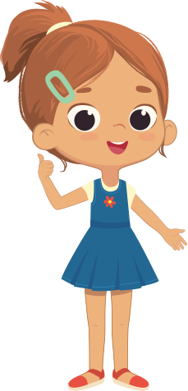
What can you say here?
Can I have a glass of water, please?
I am thirsty.
Can I go to the bathroom?

Slide 5
What can you say here?
Can I have a glass of water, please?
I am thirsty.
Give me water!

Slide 6
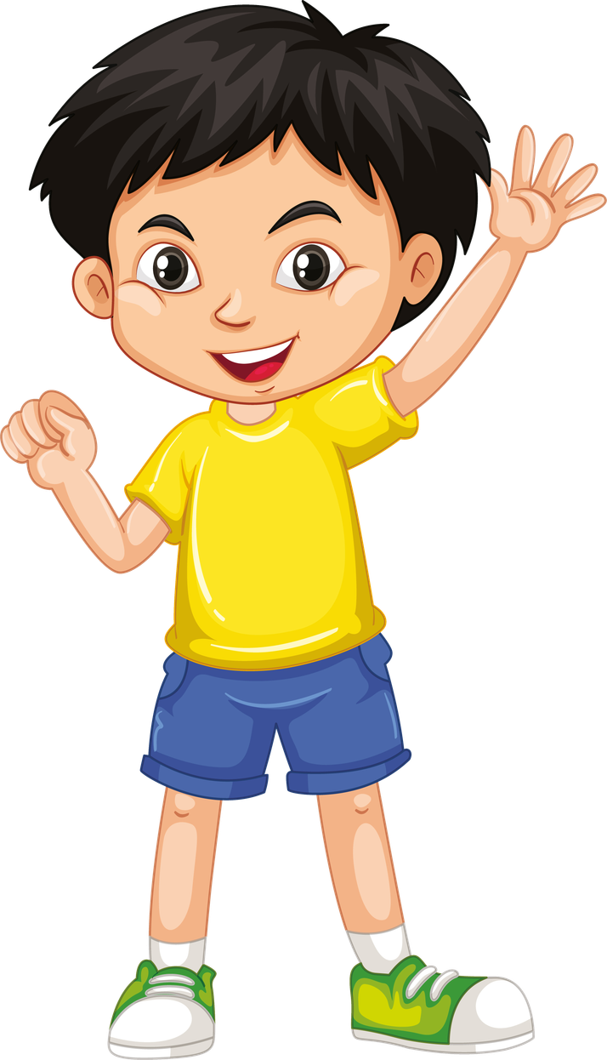
What can you say here?
I am hungry.
Can I have a pizza, please?
Can I get something to drink, please?

Slide 7
What can you say here?
I am hungry.
Can I have a pizza, please?
Give me food!

Slide 8
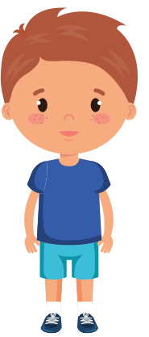
What can you say here?
I have to go to the bathroom.
Can I use the toilet, please?
Can I get something to drink, please?

Slide 9
What can you say here?
I have to go to the bathroom.
Can I use the toilet, please?
I'm going to the bathroom!

Slide 10

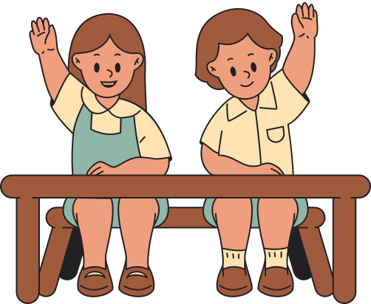
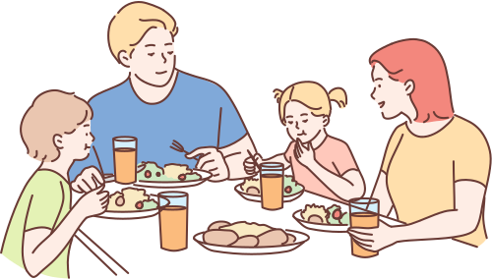
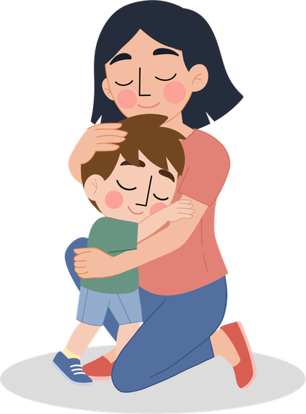



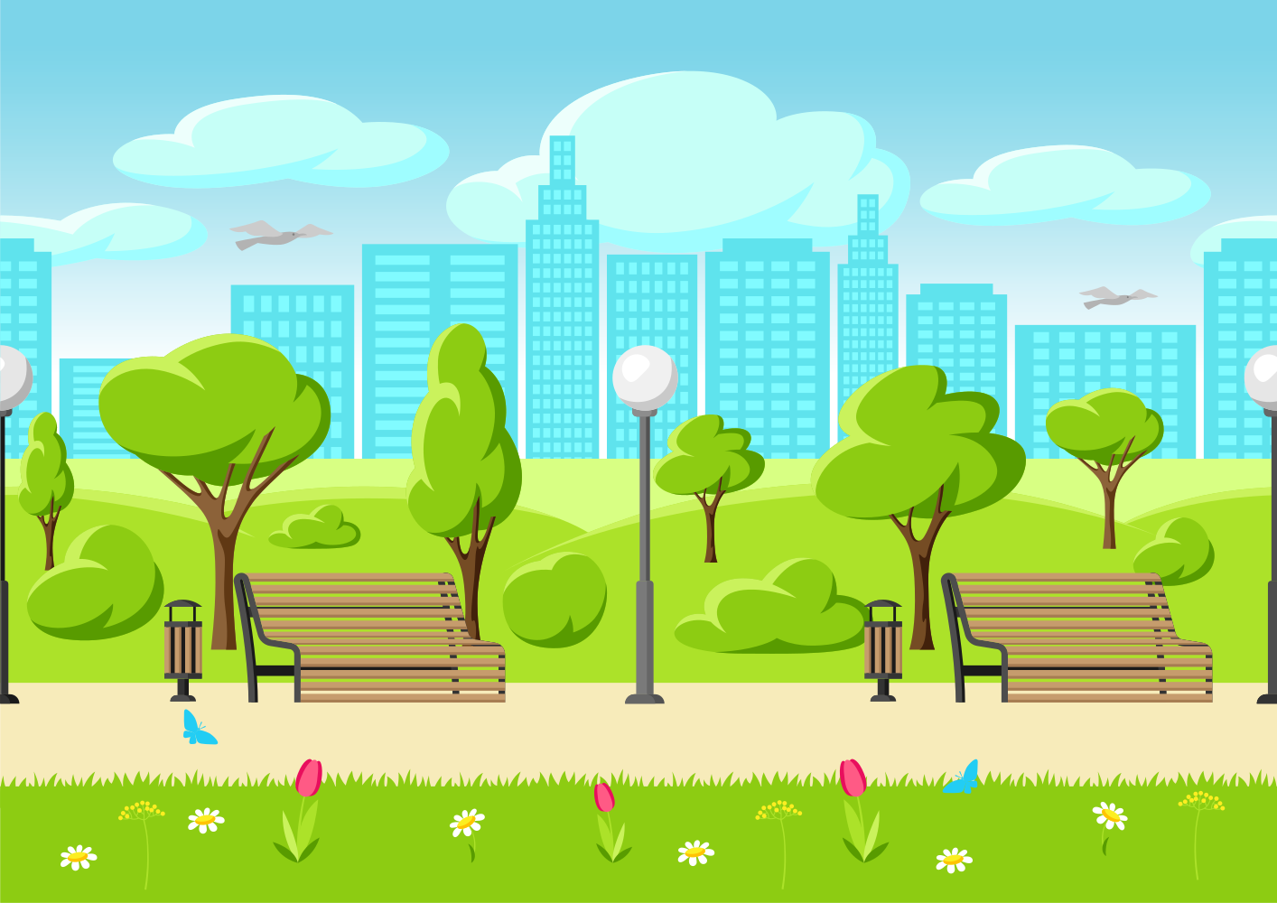

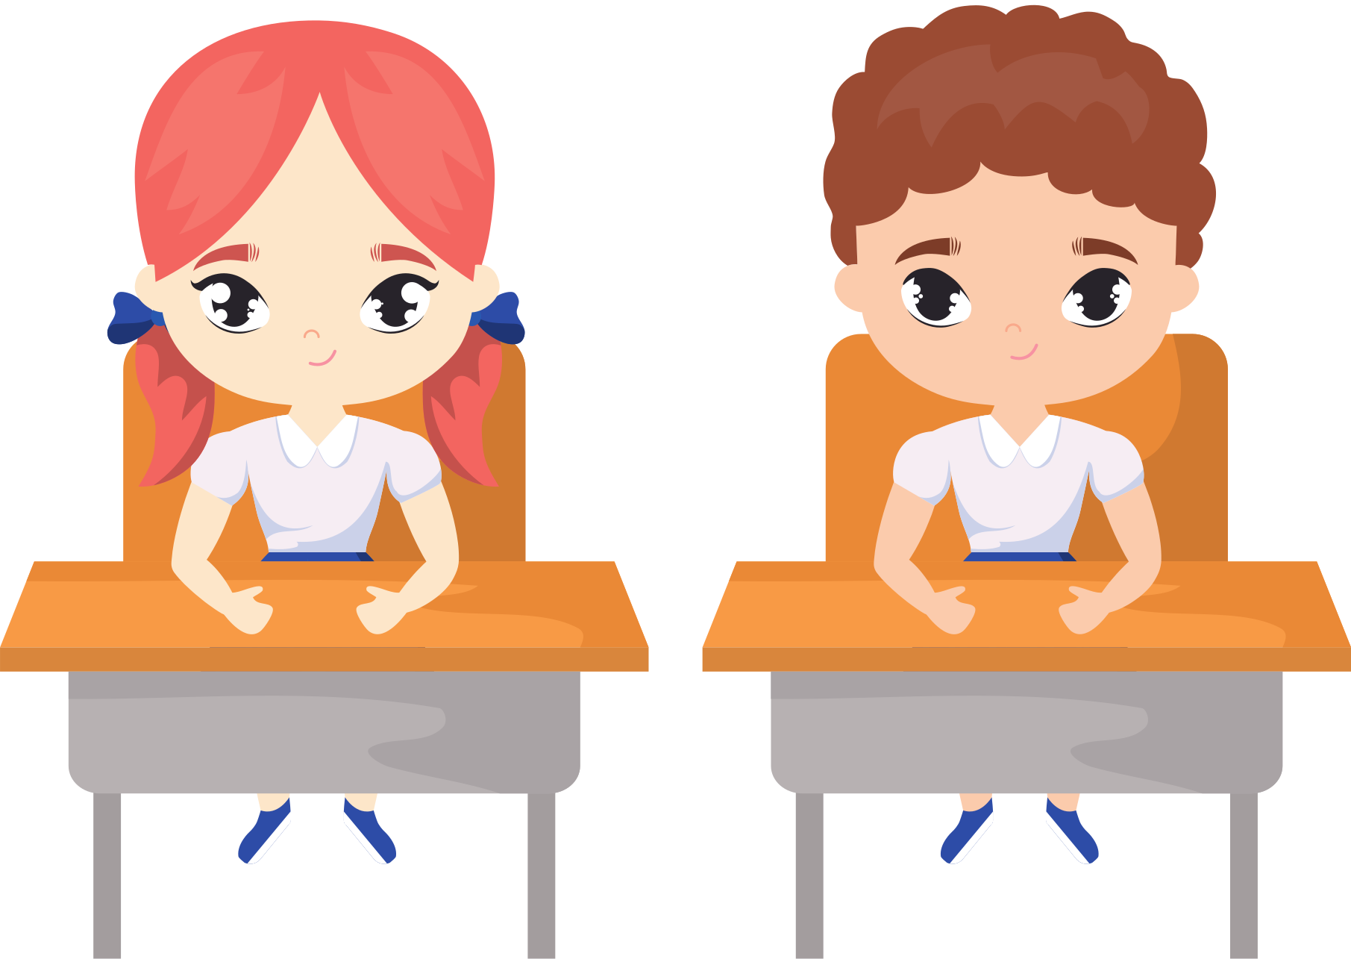
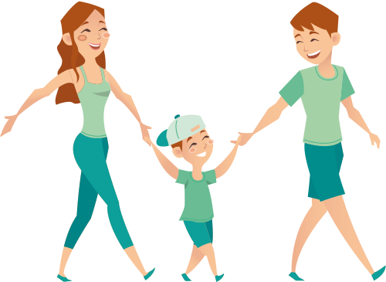





Slide 11
1) Can I have a glass of water, please?
2) Can I have a strawberry?
3) Can I go to the bathroom?
4) Can we go for a walk outside?
5) Can I have some help with this question, please?
6) Can I have a hug, please?
7) Can I please borrow a pencil?
8) Give me the ball!
9) Can I go from the table, please?
10) Can I please use my chromebook?
11) Can I please get some chocolate?
12) Can I go home?

